Slide 1
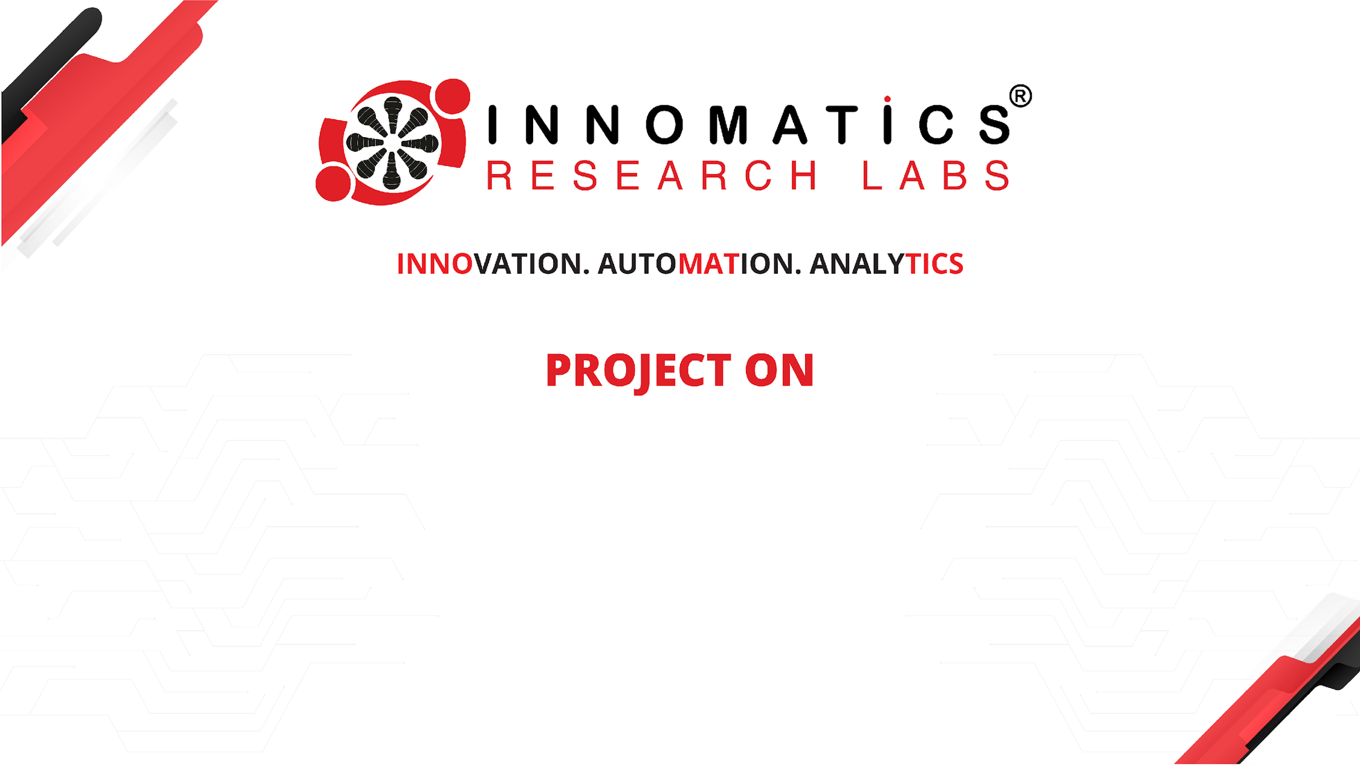
VisionBoard - Gesture Controlled
Productivity Dashboard
Presented By:
Surya Teja
Batch no: 456

Slide 2

Agenda
Introduction of this project
Introduction to OpenCV
Business Problem
proposed solution
Project Objectives
Technologies Used
System Architecture
Project Workflow / Methodology
Hand Gesture Detection Mechanism
Key Features
Challenges Faced During Development
Real-World Applications
Future Improvements
Conclusion

Slide 3
Introduction of the Project :
This project presents a Gesture Controlled Task Dashboard, an interactive computer vision system that allows users to manage daily tasks using hand gestures instead of traditional input devices like a mouse or keyboard. The system uses a webcam to detect hand movements in real time and converts them into commands for interacting with the dashboard.
The dashboard also provides visual feedback through features such as a progress bar, completion zone, and animated celebration effects, creating an engaging and interactive task management experience while demonstrating the potential of touchless human–computer interaction systems.

Slide 4
Introduction to OpenCV :
Computer Vision is a field of Artificial Intelligence that enables computers to understand and interpret visual information from images and videos. It allows machines to identify objects, detect movements, and recognize patterns from visual data.
Computer vision systems process images using algorithms and extract meaningful features that help computers make decisions based on visual input
Some common applications of computer vision include:
Face recognition systems
Gesture recognition systems
Security and surveillance systems

Slide 5
Business problem :
The current landscape of productivity tools often suffers from "Interface Fatigue"—where the friction of navigating traditional software hinders the user's flow.
Static Interaction: Standard task managers (Excel, Trello, Todoist) rely heavily on mouse clicks and keyboard shortcuts, which can feel repetitive and disconnected from physical activity.
Accessibility & Hygiene: In certain environments (e.g., medical labs, kitchens, or workshops), users need to interact with digital data but cannot touch physical peripherals due to hygiene standards or busy hands.
Lack of Engagement: Data management is often perceived as a "chore." Traditional UI/UX lacks the interactive "gamification" required to maintain high user engagement during mundane tasks.
Information Overload: Viewing a massive list of tasks without intuitive filtering makes it difficult for users to prioritize effectively based on importance.

Slide 6
Proposed Solution :
Touchless Interface: A "Minority Report" style dashboard controlled entirely via hand gestures.
Excel Integration: Converts static spreadsheets into a dynamic, interactive 2D workspace.
Gesture-Logic Mapping:
Pinch & Drag: Move and organize tasks.
Triple Pinch: "Deep Dive" into task details.
Spatial Completion: A physical "Drop Zone" to mark tasks as finished.
Real-time Feedback: Live progress tracking and gamified "Celebration Mode" animations.

Slide 7
Project Objectives:
Design and develop a real-time gesture-controlled task management dashboard using computer vision
Implement accurate hand landmark detection and gesture recognition for user interaction
Build an interactive visual interface using OpenCV to display and manage task cards dynamically
Enable gesture-based drag-and-drop task completion with real-time progress tracking
Integrate external task data from Excel for dynamic task loading and prioritization
Demonstrate a touchless human–computer interaction system for intuitive task management

Slide 8
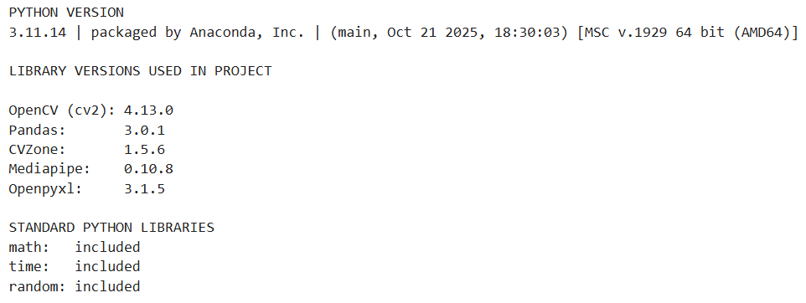
Technologies Used:

Slide 9
System Architecture
Input Layer: The webcam captures video using OpenCV.
Computer Vision Layer: CVZone and MediaPipe detect the hand and track finger landmarks.
Gesture Recognition Layer: The system interprets gestures like cursor movement (index finger), pinch (index + middle), and triple pinch (index + middle + thumb)
Application Logic Layer: A Task Manager processes gestures to perform actions such as drag & drop tasks, filtering tasks, and marking tasks as complete.
Data Layer: Tasks are stored in an Excel (.xlsx) file and converted into Python task objects.
Dashboard Rendering Layer: The UI displays task cards, progress bars, completion feedback, popups, and celebration animations when tasks are finished.
Notes:
5

Slide 10
Hand Gesture Detection Mechanism
Index + Middle Finger Gesture: Used to select or drag tasks on the dashboard.
Triple Pinch Gesture (Index + Middle + Thumb): Used to open and view task details.
Notes:
7

Slide 11
Key Features:
Gesture-Based Interaction – Users can control the dashboard using hand gestures without a mouse or keyboard.
Real-Time Hand Tracking – MediaPipe detects hand landmarks in real time for accurate gesture recognition.
Interactive Drag-and-Drop Tasks – Tasks can be selected and moved across the screen using pinch gestures.
Task Prioritization System – Tasks are categorized as Normal, Medium, or High importance for better organization.
Dynamic Progress Tracking – A visual progress bar updates automatically as tasks are completed.
Gamified Feedback System – Completion animations and celebration effects enhance user engagement.

Slide 12
Challenges :
Raw Data Jitter:
Challenge: Raw hand landmark coordinates from the webcam are naturally unstable, leading to a "shaking" cursor.
Coordinate Mirroring & Mapping:
Challenge: Standard webcam feeds are inverted, making natural "left-to-right" navigation counter-intuitive for the user.
Gesture Collision Sensitivity:
Challenge: Defining the exact Euclidean distance threshold for a "pinch" that works for different hand sizes and distances from the camera.
UI Depth & State Management:
Challenge: Managing overlapping UI elements (like the Info Popup appearing over the Dashboard) without losing the background frame.
Environment Lighting & Occlusion:
Challenge: Maintaining high detection confidence (detectionCon=0.6) in varying light conditions.

Slide 13
Real-World Applications :
Sterile Medical Environments: Surgeons or lab technicians can interact with patient data, X-rays, or task checklists without touching physical screens or keyboards, maintaining strict hygiene protocols.
Smart Manufacturing & Workshops: Engineers in oily or hazardous environments can navigate technical manuals or log completion of maintenance tasks "hands-free."
Public Information Kiosks: Implementing touchless navigation in high-traffic areas (airports, malls, or museums) to reduce the spread of germs on physical touchscreens.
Enhanced Accessibility (Assistive Tech): Providing an alternative input method for individuals with motor impairments who may find traditional mouse/keyboard interaction challenging.
Interactive Retail & Digital Signage: Creating immersive "Storefront" experiences where customers can browse catalogs or customize products through mid-air gestures.
Immersive Education: Transform traditional classroom settings into interactive learning environments where students interact with 3D-mapped data or digital modules physically.

Slide 14
Future Improvements :
Advanced Gesture Recognition – Add more gesture types for additional controls such as task editing, deleting, or navigation.
Multi-Hand and Multi-User Support – Extend the system to detect multiple hands for collaborative interaction.
Database Integration – Replace Excel with a database system for scalable task storage and management.
Improved UI Design – Develop a more advanced graphical interface with richer visual elements and smoother animations.
Mobile or Web Integration – Expand the system to work with mobile devices or web-based dashboards for broader accessibility.
Face Recognition for User Identification – Integrate face recognition so the system identifies the user and loads their personalized task list automatically.

Slide 15
Conclusion :
This project demonstrates a Gesture Controlled Task Dashboard that enables users to manage tasks through natural hand gestures using computer vision. By integrating OpenCV, MediaPipe, and CVZone, the system detects hand movements in real time and allows users to interact with tasks through gesture-based actions such as selecting, dragging, and completing tasks. The project highlights the potential of touchless human–computer interaction for creating more intuitive and interactive digital systems.

Slide 16
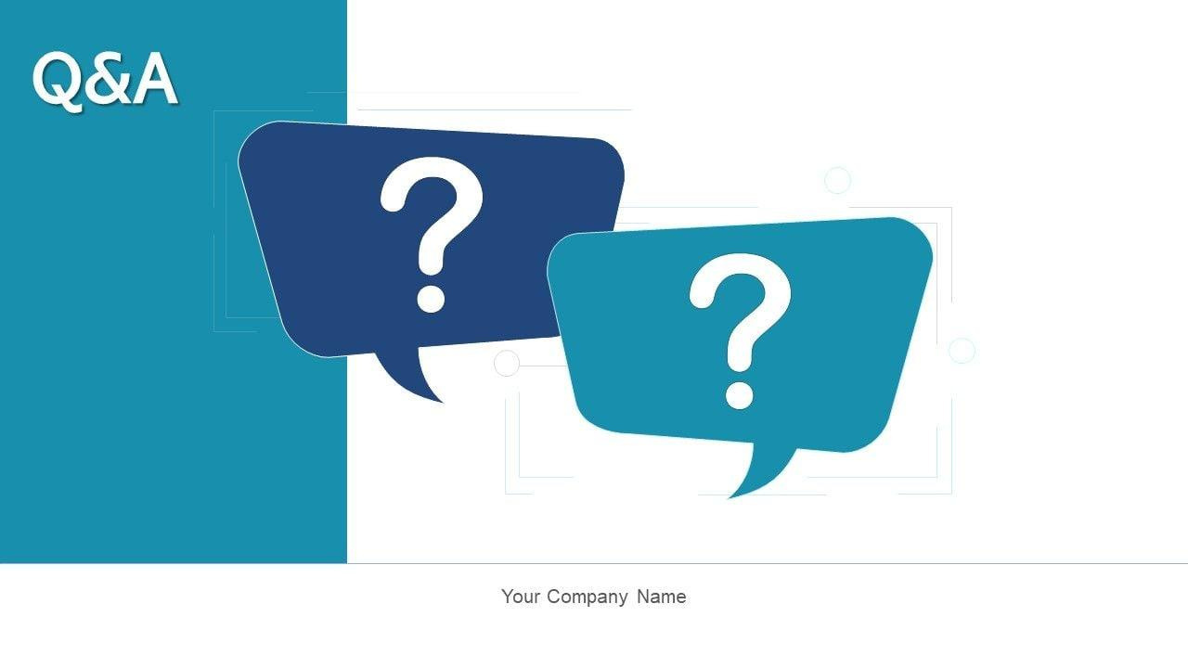

Slide 17

THANK YOU

